Slide 1
Beyond the Tarmac: Predicting Airline Delay Causes
Shreyon Roy
Crystal Zhang
Dorien Zhang
CS-GY 6513 Big Data Spring 2026 Section D

Slide 2
Contents
1.
Data Source
2.
Objectives
3.
Tools & Processing
4.
Analysis & Visualizations
5.
Prediction Model Demo
6.
Conclusion

Slide 3
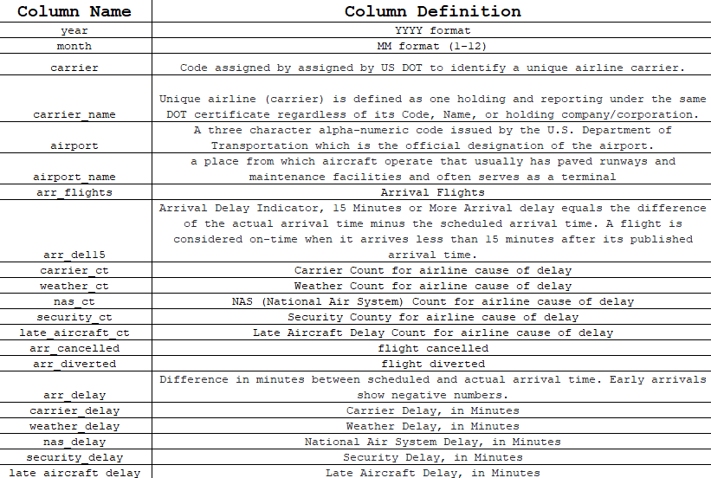
Data Source
Dataset
Details
Source: United States Bureau of Transportation Statistics
Size: 67.4 MB
Records: 417,124
Each record contains flight delay information on an airline at a given airport. The selected dataset is from June 2003-November 2025.

Slide 4
Objectives
Goal
Data processing
Analysis
Prediction
Clean the dataset to prevent interference with the data analysis
Consider trends between certain delay causes and identify important correlations
Train a model based on historical data for each airport and carrier
Use the model to predict the airline delay information at a given airport

Slide 5
Tools
Processing
Analysis
Model
Python (Pandas)
Matplotlib (Jupyter Notebook)
Observable Framework
DuckDB
D3.js
PySpark

Slide 6
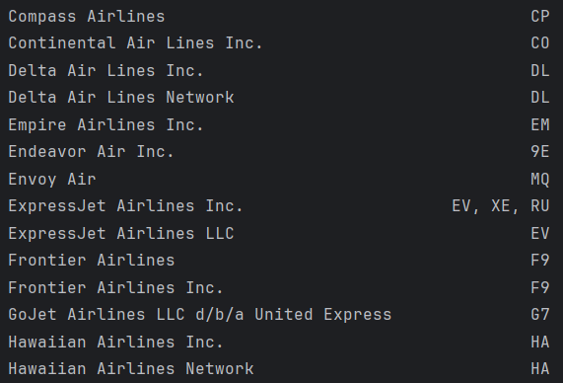
Processing
We checked for invalid data:
incorrect year, month, airport code
duplicate/missing records
Carrier names were modified for our data to have a unique key.
Ex. the carrier and carrier code fields were not unique

Slide 7
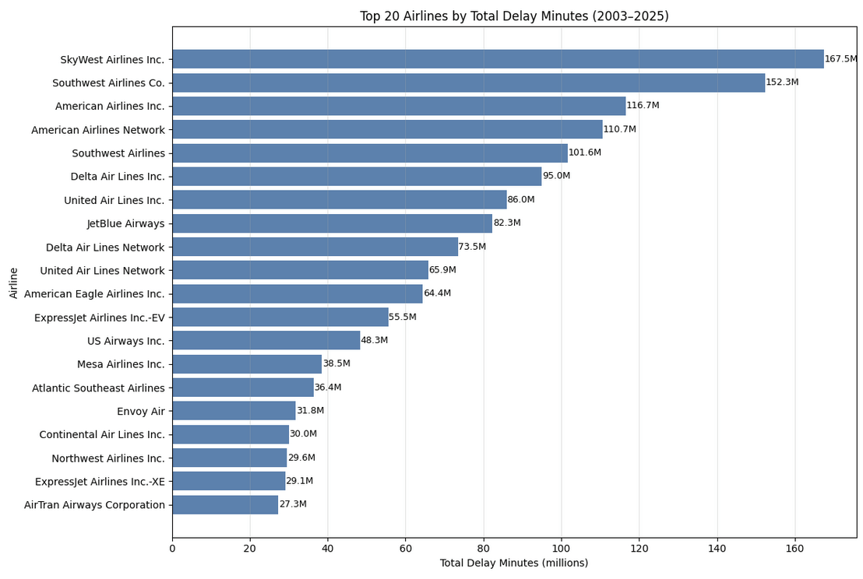
Visualizations (matplot)

Slide 8
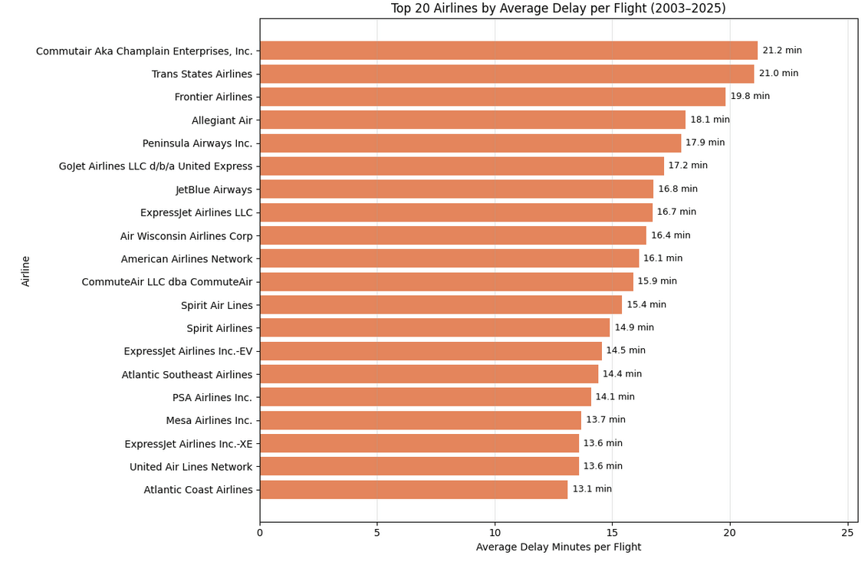
Visualizations (matplot)

Slide 9
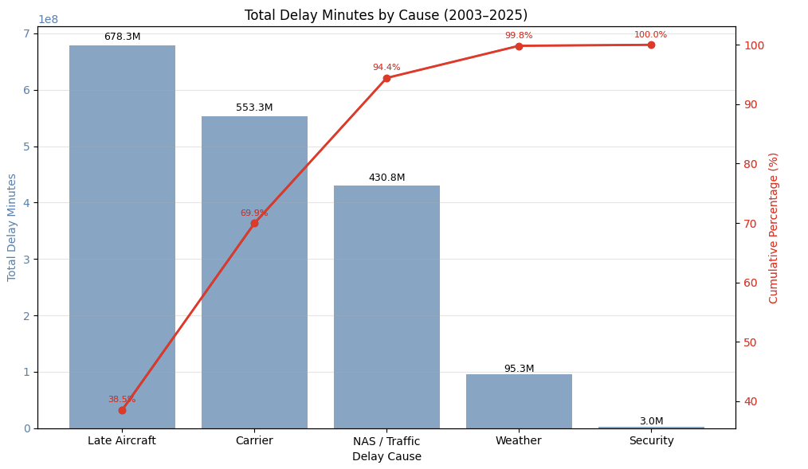
Visualizations (matplot)

Slide 10
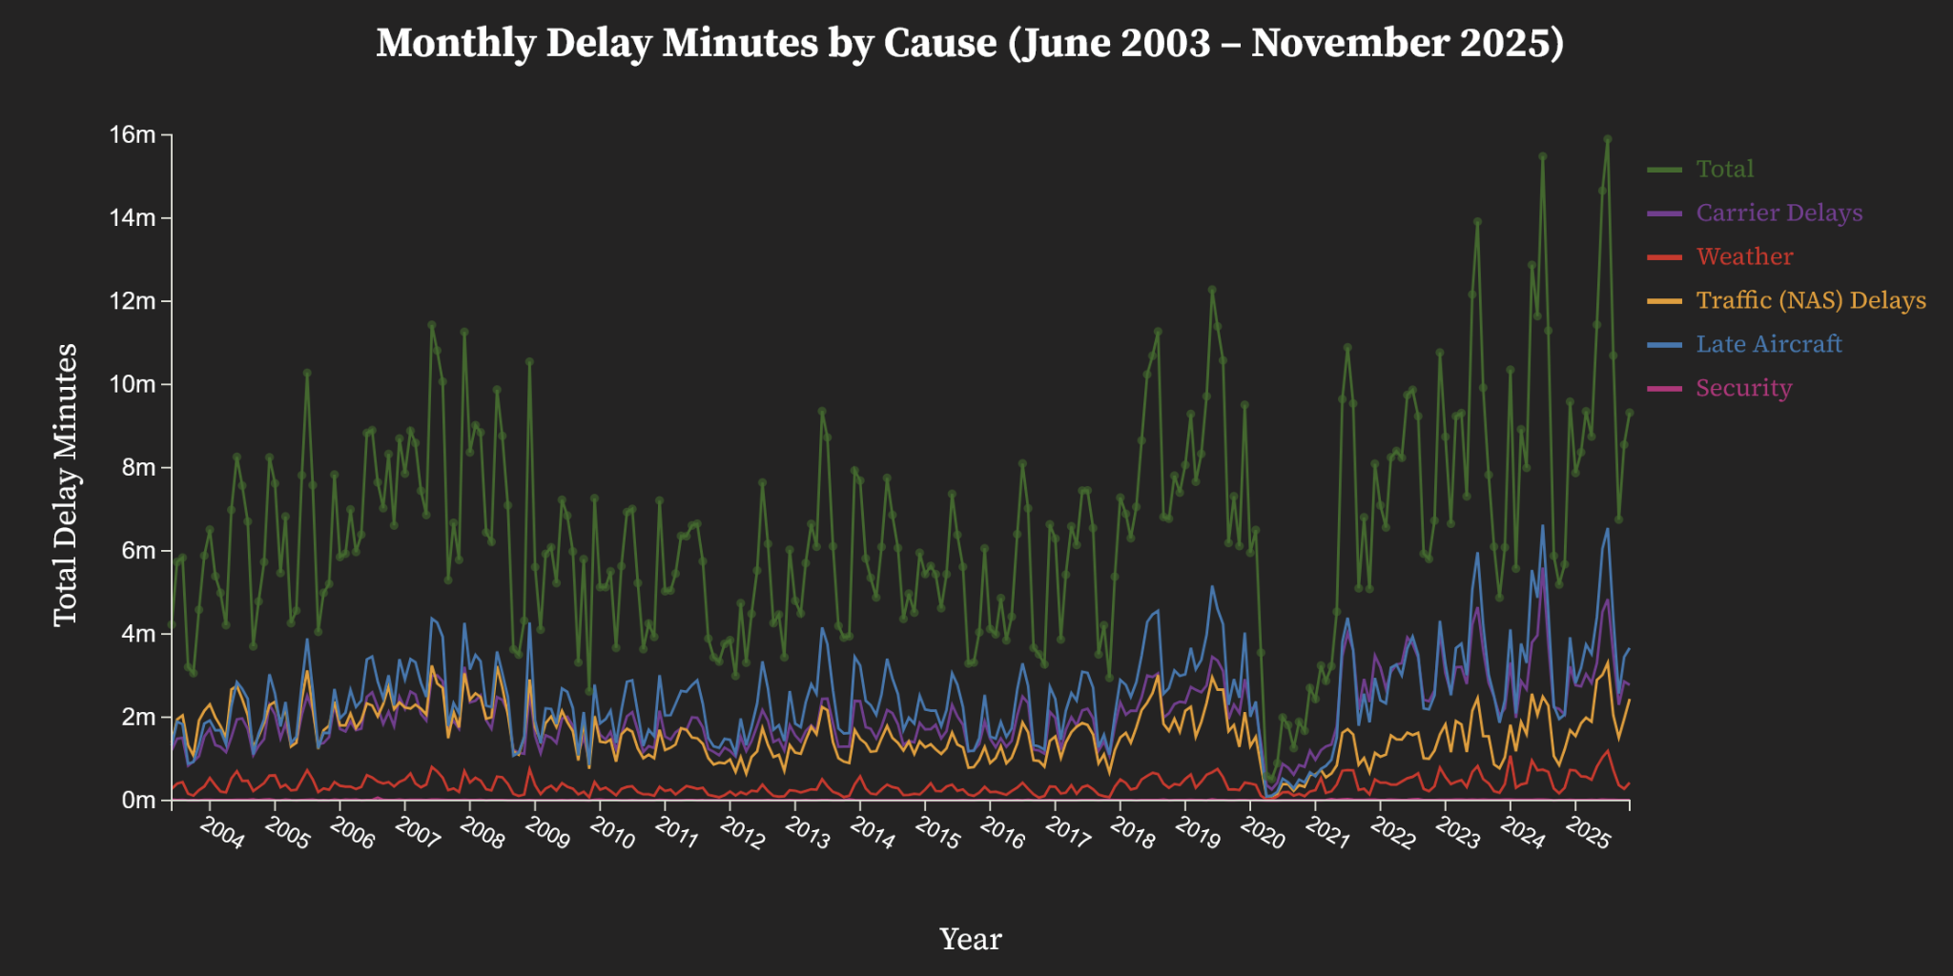
Visualizations (d3)

Slide 11
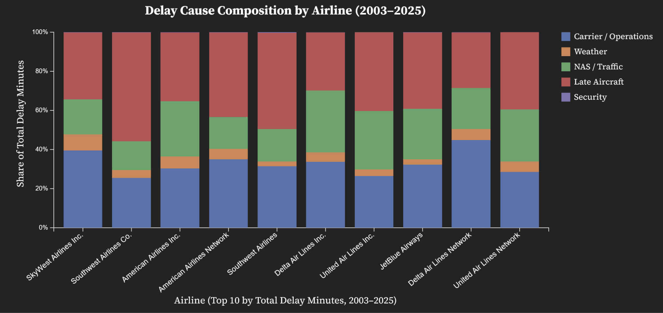
Visualizations

Slide 12
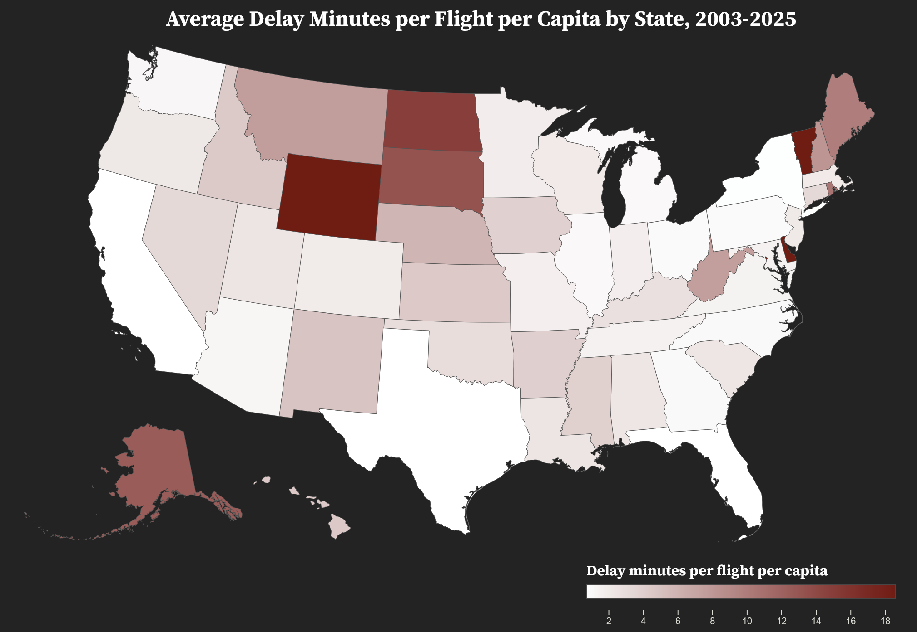
Visualizations

Slide 13
Demo

Slide 14
Questions?

Slide 15
Thank you

